Slide 1












Finding and Understanding Defects in Static Analyzers by Constructing Automated Oracles
Weigang He, Peng Di, Mengli Ming, Chengyu Zhang, Ting Su, Shijie Li, Yulei Sui
Feb 16, 2024
Notes:
Hi everyone, I am weigang.
I am so glad to be here to introduce our work: Finding and Understanding Defects in Static Analyzers.
This work was completed together with Peng Di, Mengli Ming, Chengyu Zhang, Ting Su, Shijie Li, Yulei Sui.

Slide 2
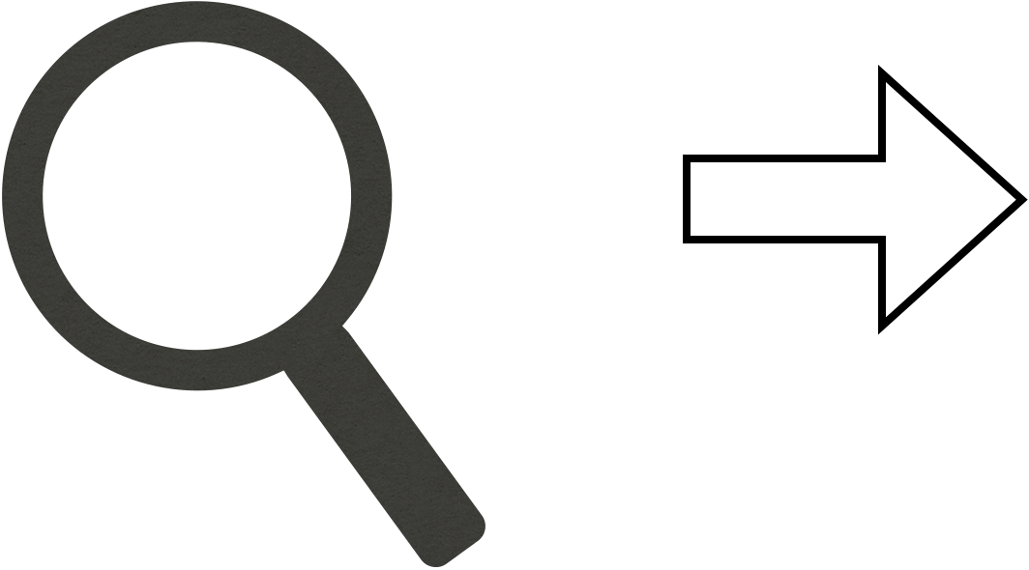
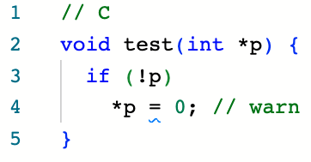

Background
Static Analyzers aim to find program bugs or vulnerabilities
True Positive
Clang Static Analyzer
2
Notes:
First of all, let me introduce some background.
Static Analyzers aim to find program bugs or vulnerabilities
Given this example program on the right side, CSA can correctly identify the NPD error in the program at line 4,

Slide 3
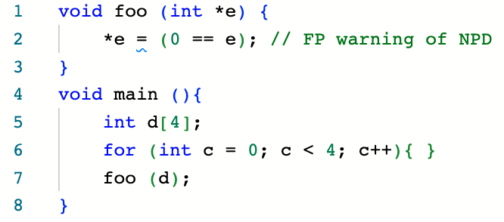


Background
Static Analyzers have false positives (FPs)
FP
Clang Static Analyzer
3
Notes:
However, Static Analyzers have false positives.
Given this example program on the right side, CSA would falsely report an NPD error in the program at line 2,

Slide 4
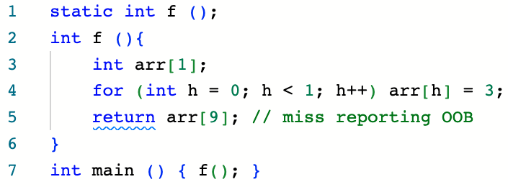
Background
Static Analyzers have false negatives (FNs)
FN
GCC Static Analyzer
4
Notes:
And, Static Analyzers have false negatives.
Given this example program on the right side, GSA would miss reporting an OOB error in the program at line 5 when GCC optimization level is -O1 or above.
FPs and FNs are representations of defects in static analyzers.
Our work aims to find the defects in static analyzers.

Slide 5
Challenges
Static analyzers usually do not have clear and complete specifications.
Different Static analyzers' analysis results could be different.
- Trade-off the soundness and precision
- Warning line
- Warning type name
5
Notes:
Our work aims to find those kind of defect in static analoyzers.
One key difficulty is the oracle problem
On one hand, since static analyzers usually do not have clear and complete specifications, they are difficult to be formally verified like compilers.
On the other hand, since static analyzers usually use different strategies to trade-off the soundness and precision, their analysis results are difficult to be validated by differential testing.

Slide 6

Two Types of Automated Oracles
The dynamic oracle
The static oracle
6
Notes:
To find defects in the static analyzer, we propose two type of oracles. …

Slide 7
Insights
Dynamic oracle: Ideally, the results inferred by a static analyzer should be consistent with the results of running the program.
7
Notes:
Ideally, the results inferred by a static analyzer’s checker
on a program should be consistent with the results obtained by running the program.

Slide 8
Insights
Dynamic oracle: Ideally, the results inferred by a static analyzer should be consistent with the results of running the program.
Static oracle: A static analyzer should evaluate equivalent but different representations of bool expressions for the same results.
8
Notes:
Ideally, the results inferred by a static analyzer’s checker
on a program should be consistent with the results obtained by running the program.
our insight is to generate equivalent but different representations of such boolean expressions
to stress test the static analysis results. This is inspired by metamorphic testing.
I will show more details later.

Slide 9
Dynamic Oracle
The program’s execution paths can be leveraged to construct the oracle for testing static analyzers.
Dynamic Execution Path | Static Analysis Result | Testing Result
No error | Warning | FP
Error | No warning | FN
9
Notes:
OK, let’s dive a bit more into what the dynamic oracle is. The key idea is very simple. The program with only one execution path can serve as the dynamic oracle for a static analyzer

Slide 10
Dynamic Oracle
The program’s execution paths can be leveraged to construct the oracle for testing static analyzers.
Dynamic Execution Path | Static Analysis Result | Testing Result
No error | Warning | FP
Error | No warning | FN
10
Notes:
Let’s take FP as an example. And see how to construct a dynamic oracle.

Slide 11
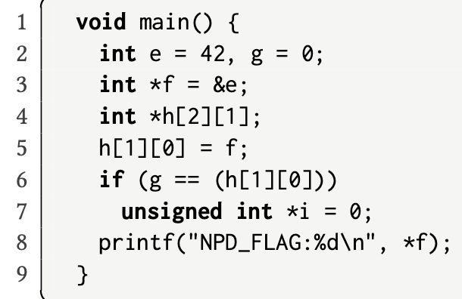
Constructing Dynamic Oracle
3
11
Notes:
Constructing a dynamic oracle is very easy. First, we need to run the program given on the right side. On line 3, variable f is assigned with the address of e.

Slide 12
Constructing Dynamic Oracle
3
4
12
Notes:
On line 4, we declare a pointer array h.

Slide 13
Constructing Dynamic Oracle
3
4
5
13
Notes:
On line5, h[1][0] is assigned with f. So h[1][0] is the address of e.

Slide 14
Constructing Dynamic Oracle
3
4
5
6
T
F
14
Notes:
Line 6 is an ‘if’ statement, and because g is 0 and h[1][0] is the address of e, the false branch is taken.

Slide 15
Constructing Dynamic Oracle
3
4
5
6
T
F
7
8
No runtime error!
15
Notes:
Finally, it successfully print the number 42. right.

Slide 16
Testing Result
3
4
5
GCC static analyzer reports an NPD
6
T
FP
F
7
8
No runtime error!
16
Notes:
However, GSA says there is an NPD on line 8. So it is a false positive. This is actually due to an implementation error. The developer only consider the comparison with 0 when o is on the right side. Here, the variable g, which is 0, is on the left side. So the analyzer think that the true branch is feasible. But if you put the variable g on the right side. It would not give the NPD warning. The developer have fixed this.

Slide 17
Dynamic Oracle
The program’s execution paths can be leveraged to construct the oracle for testing static analyzers.
Dynamic Execution Path | Static Analysis Result | Testing Result
No error | Warning | FP
Error | No warning | FN
17
Notes:
Similarly, we can insert a bug in a execution path, if static analyzers can not find the bug, we find an FN.

Slide 18

Static Oracle
Some static analyzers have debugging functions that can inspect the facts of the analyzed program.
Static Analyzer | Debugging Function
GCC Static Analyzer | __analyzer_eval()
Clang Static Analyzer | clang_analyzer_eval()
18
Notes:
Next, let me introduce static oracle. But before that, let me explain what is debugging functions. Let’s take the bugging function __analyzer_eval() in GSA as an example.

Slide 19
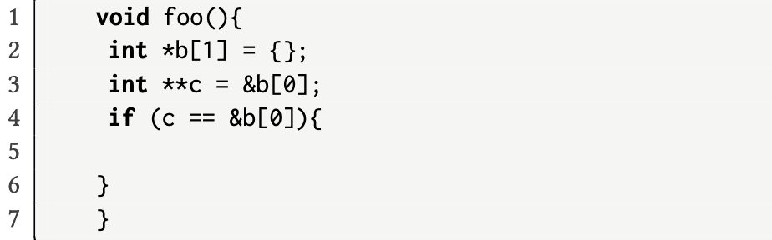
Debugging Function
19
Notes:
Here is a simple program.

Slide 20
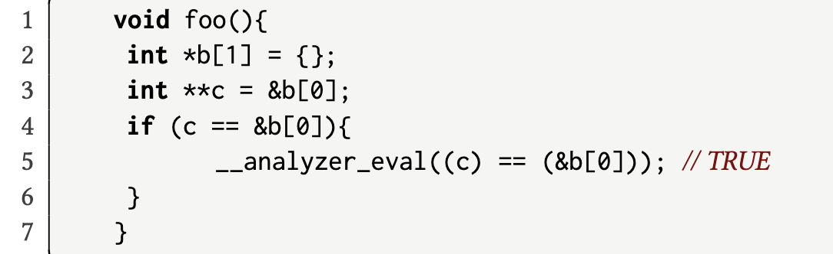
Debugging Function
GCC Static Analyzer
evaluates the result
<source>:5: TRUE
20
Notes:
We can inset a expression, which is the condition of the if statement, wrapped with the debugging function __analyzer_eval(). Given this program, GSA will output the evaluation result of this expression. Here, it is true.

Slide 21
Constructing Static Oracle
21
Notes:
Ok, let’s dive into how to construct static oracles. Here is the same program.

Slide 22
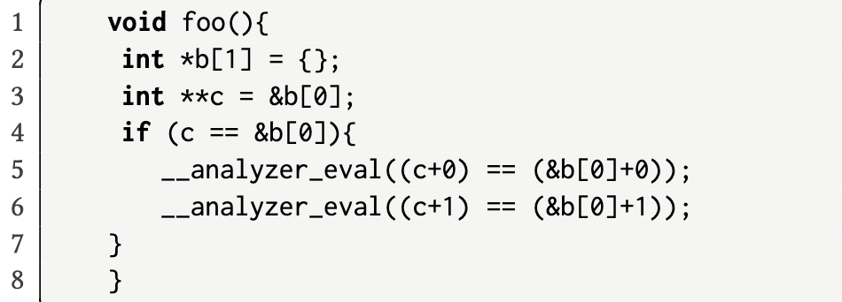
Constructing Static Oracle
22
Notes:
We can do some tautologic mutation of the if conditions, And wrap them with debugging function. And here, insert them on line 5 and 6.

Slide 23
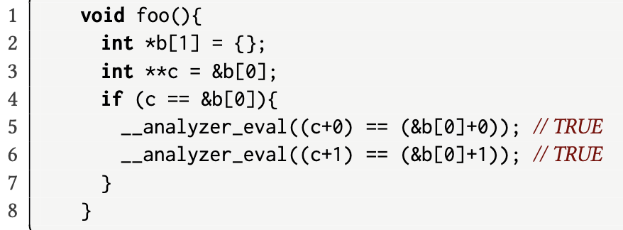
Testing Result
GCC Static Analyzer
evaluates the result
23
Notes:
The ground truth of those expressions are all true, right? We give this program to GSA.

Slide 24
Testing Result
GCC Static Analyzer
evaluates the result
GCC Static Analyzer gets inconsistent with ground truth
<source>:5: TRUE
<source>:6: FALSE
24
Notes:
GSA says line 5 is true, but line 6 is false, which is not right. Hence, we find a defect in GSA.

Slide 25
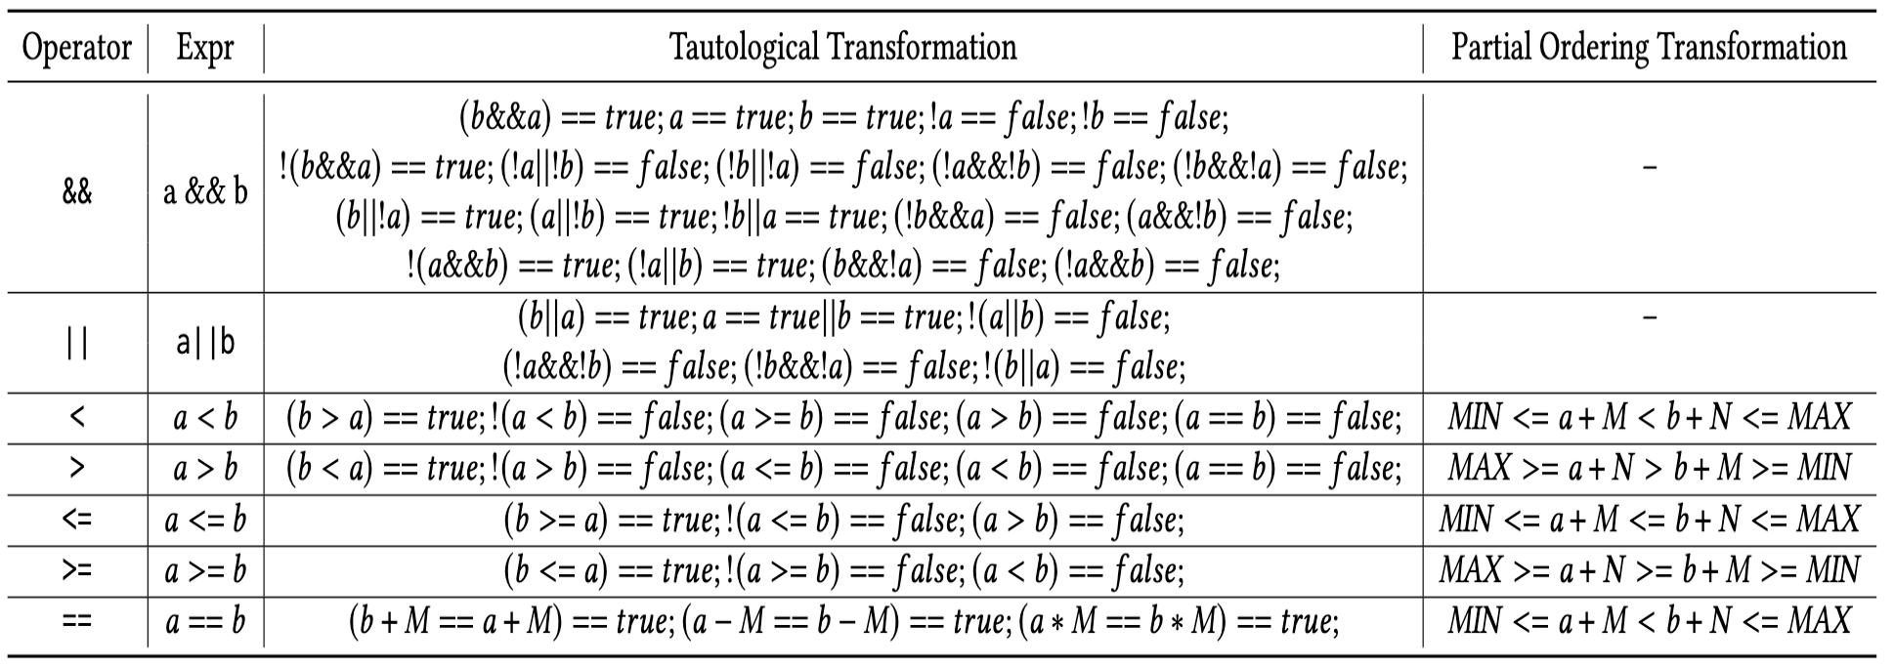
Mutation Strategies
25
Notes:
This table show all the Mutation Strategies .

Slide 26
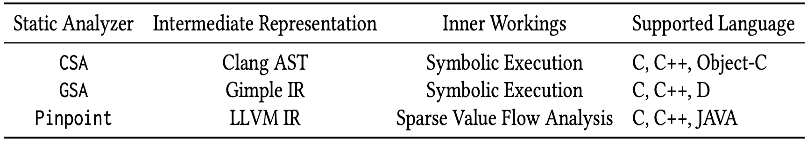
Experiment
26
Notes:
We applied the two oracles to 3 static analyzers. CSA. GSA, and Pinpoint.

Slide 27
Experiment
From September 2022 to July 2023
2. Generated 13,500 programs with dynamic oracles and 4,600 programs with Static oracles
3. Inspected about 200 defects after deduplication
27
Notes:
Introduce 一下实验的内容。

Slide 28
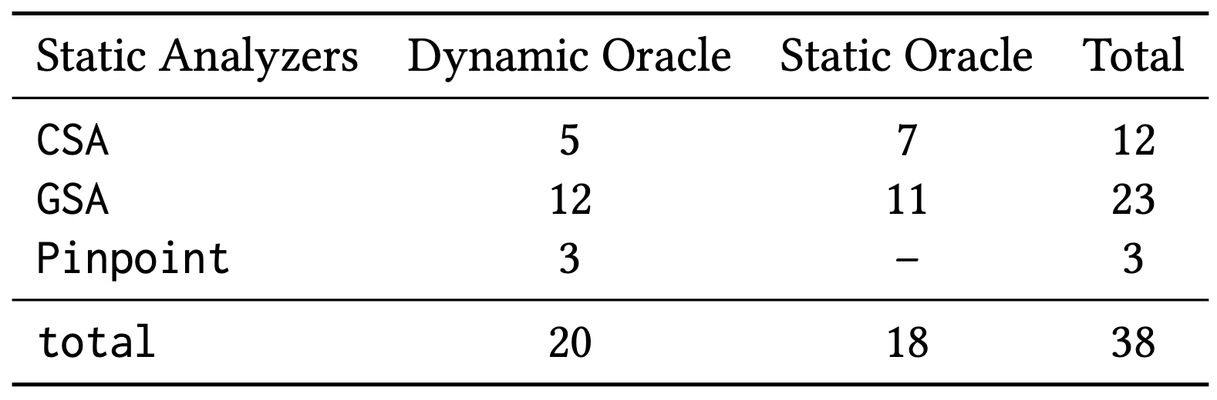
Results of Found Defects
28
Notes:
Specifically, the dynamic oracle found 5, 12, and 3 defects in CSA, GSA, and Pinpoint, respectively, while the static oracle found 7 and 11 defects in CSA and GSA, respectively. Overall, the dynamic and static oracle found 20 and 18 defects, respectively. The number of defects found in CSA, GSA, and Pinpoint are 12, 23, and 3, respectively. In total, we found 38 defects in the three static analyzers

Slide 29
Results of Found Defects
28 of 38 defects have been confirmed
5 defects have been fixed by the developers.
29
Notes:
28 of 38 defects have been confirmed
5 defects have been fixed by the developers.

Slide 30
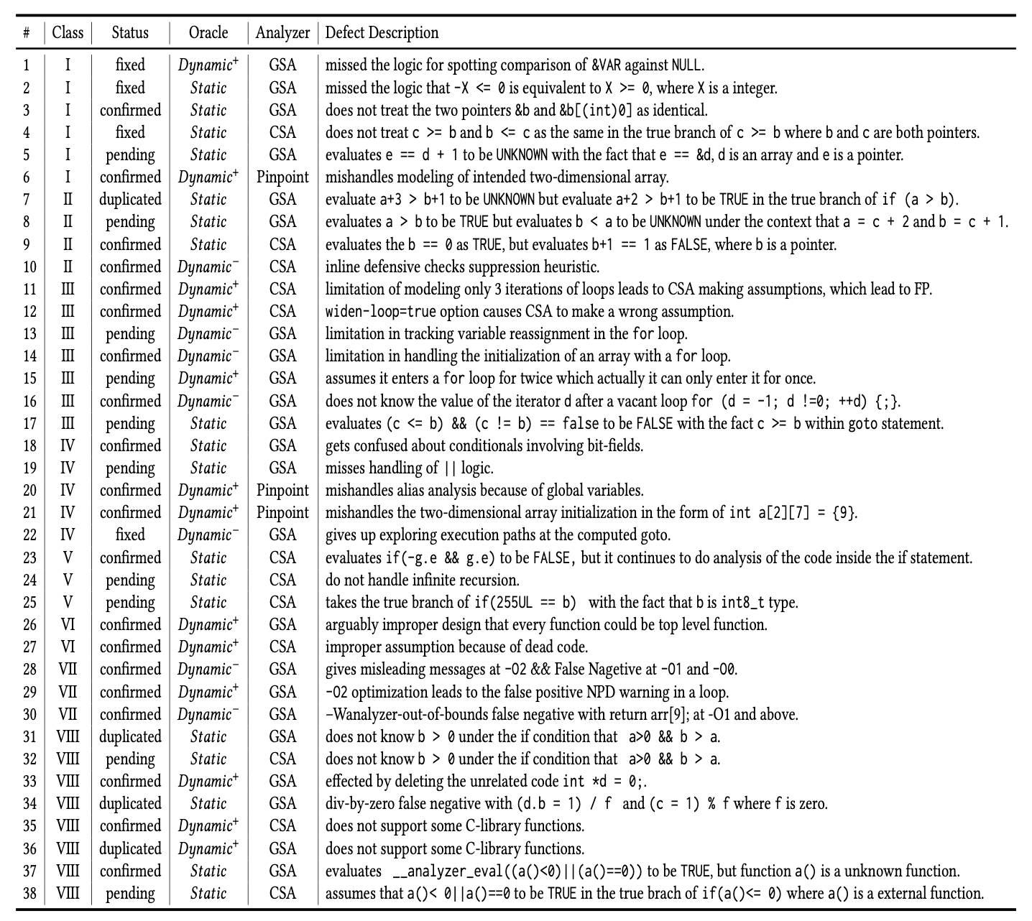
Results
30
Notes:
之前的工作都是测试静态分析工具的部分模块，我们是测试整体的静态分析工具。

Slide 31
Results
31
Notes:
We classify those defects and conduct a case study of those defects.

Slide 32
Classification of the Found Defects
No. | Class | # Defects
I | Implementation Errors | 6
II | Defects in Heuristics | 4
III | Defects in Handling Loops | 7
IV | Mishandling Language Features | 5
V | Overly Eager Assumption | 3
VI | Defects Induced by Design Choices | 2
VII | Defects Induced by Compiler Optimizations | 3
VIII | Others | 8
32
Notes:
We have found so many defects, and then we need to understand those defects. We classified them into 8 classes. I selected 4 classes for explanation with illustrative exmaples.

Slide 33
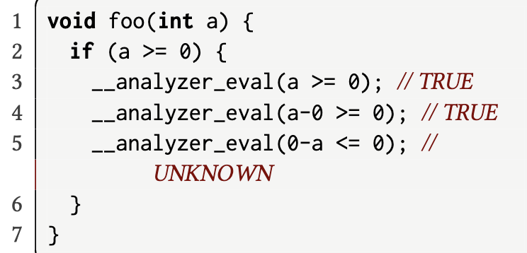
Implementation Errors (I)
GSA: Static Oracle
Wrong Evaluation Result
33
Notes:
The first class is implementation errors.
This example defect is found in GSA through the static oracle.

Slide 34
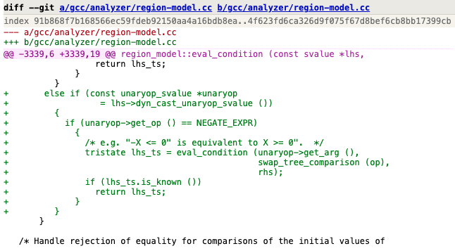
Implementation Errors (I)
Root Cause:
Miss-handling comparisons against negated symbolic values
34
Notes:
Added a patch to the constraint manager that looks up the commutative form of the expressions like “X >= 0”, and treats them as the same.

Slide 35
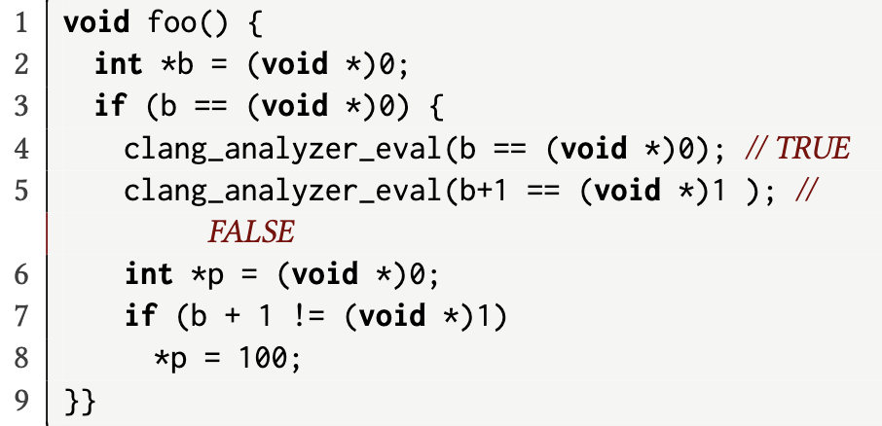
Defects in Heuristics (II)
CSA: Static Oracle
Wrong Evaluation Result
35
Notes:
The second class is defects in Heuristics.
This example defect is found in CSA through the static oracle.

Slide 36
Defects in Heuristics (II)
Root cause:
CSA’s hack for null pointer dereference (NPD) analysis.
36
Notes:
The developers recognized it as an “ugly hack" to aid in NPD analysis and assumed that it was reasonable to diagnose dereferencing a pointer x+1 as an NPD,
CSA evaluates the condition b == 0 on line 4 as TRUE, but evaluates b+1 == 1 on line 5 as FALSE, leading to contradictory results.

Slide 37
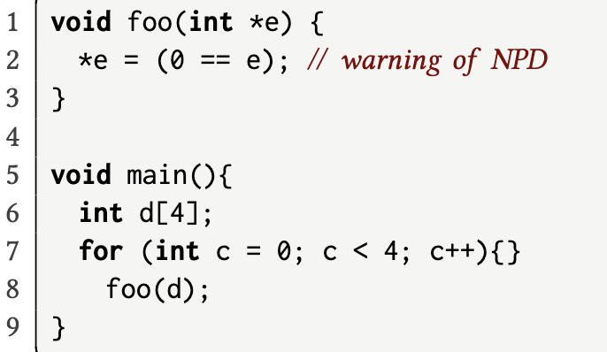
Defects in Handling Loops (III)
CSA: Dynamic Oracle
False Positive Warning
37
Notes:
The 3rd class is defect in handling loops.
This example defect is found in CSA through the dynamic oracle.
CSA will not give this warning if the loop condition (at line 7) is set to c < 3. This inconsistency may confuse the CSA’s users.

Slide 38
Defects in Handling Loops (III)
Root cause:
CSA by default models at most three iterations of loops before stopping on that path
38
Notes:
CSA will not give this warning if the loop condition (at line 7) is set to c < 3. This inconsistency may confuse the CSA’s users.

Slide 39
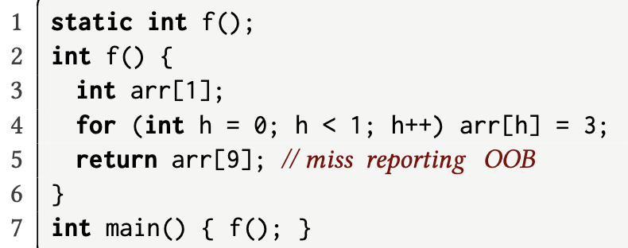
Defects Induced by Compiler Optimizations (VII)
GSA: Dynamic Oracle
False Negative
39

Slide 40
Defects Induced by Compiler Optimizations (VII)
Root cause:
At -O1 and above, the arr[9] access is optimized away before the analyzer sees it.
40

Slide 41
Lessons Learned
Implementation errors should be avoided.
Static analyzers should clarify the nature and extent of unsoundness.
Compiler optimizations affect GSA’s static analysis results.
Both False negatives and positives are important.
41
Notes:
可以加讨论的其他的内容

Slide 42
Discussion
The dynamic and static oracles are complementary in finding defects:
Dynamic Oracle can not reach dead code (e.g., defect #19).
Static Oracle cannot find the defects in handling the for loops (e.g., defect #11).
42
Notes:
可以加讨论的其他的内容

Slide 43
Discussion
The dynamic and static oracles are complementary in finding defects.
Line coverage of static analyzers achieved by the automated oracles:
Oracle Types | CSA | GSA
Dynamic Oracle | 49.6% | 44.6%
Static Oracle | 45.9% | 43.5%
43
Notes:
We also inspected the line coverage achieved by those two kind of oracles.

Slide 44
Conclusion
Proposed two kinds of oracles
Finding 38 unique defects
Classifying those defects into 8 classes
44

Slide 45
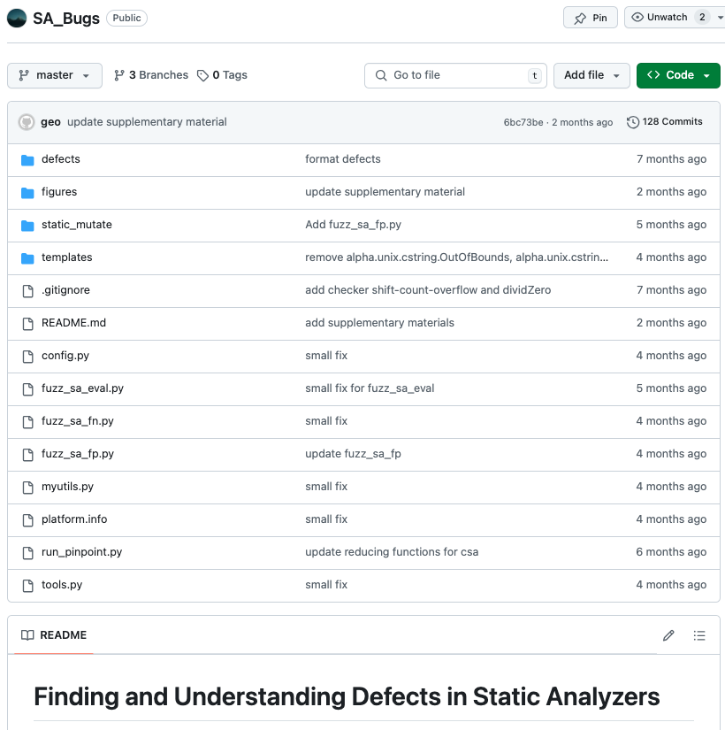

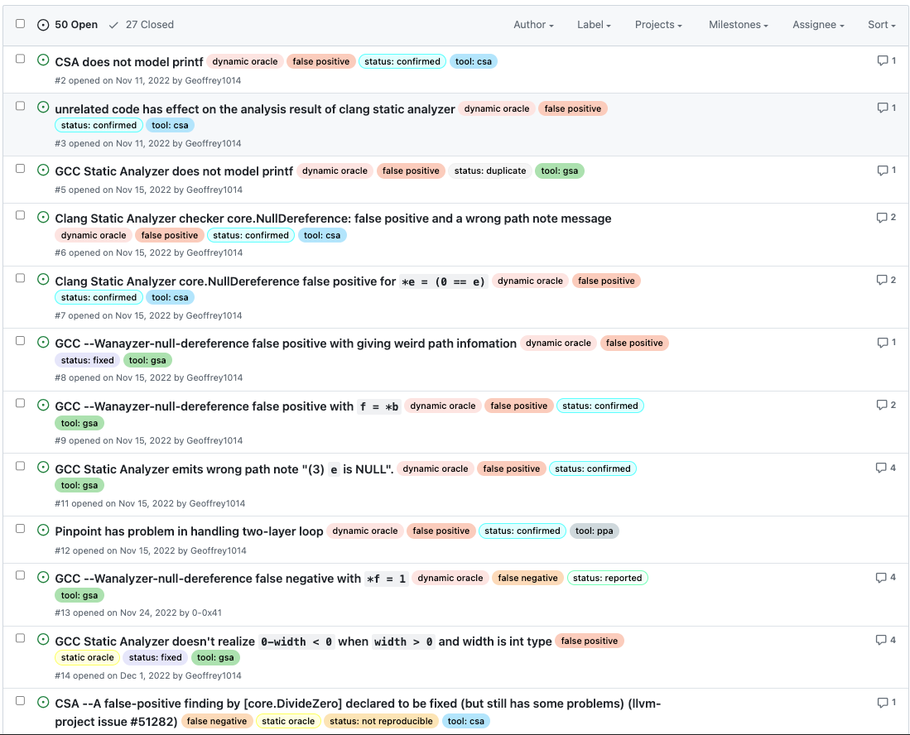
Artifact: https://github.com/Geoffrey1014/SA_Bugs
Tutorial
Bug Dataset
Active Maintenance
45

